Slide 1

GCSE FRENCH
Where can it take you?

Slide 2
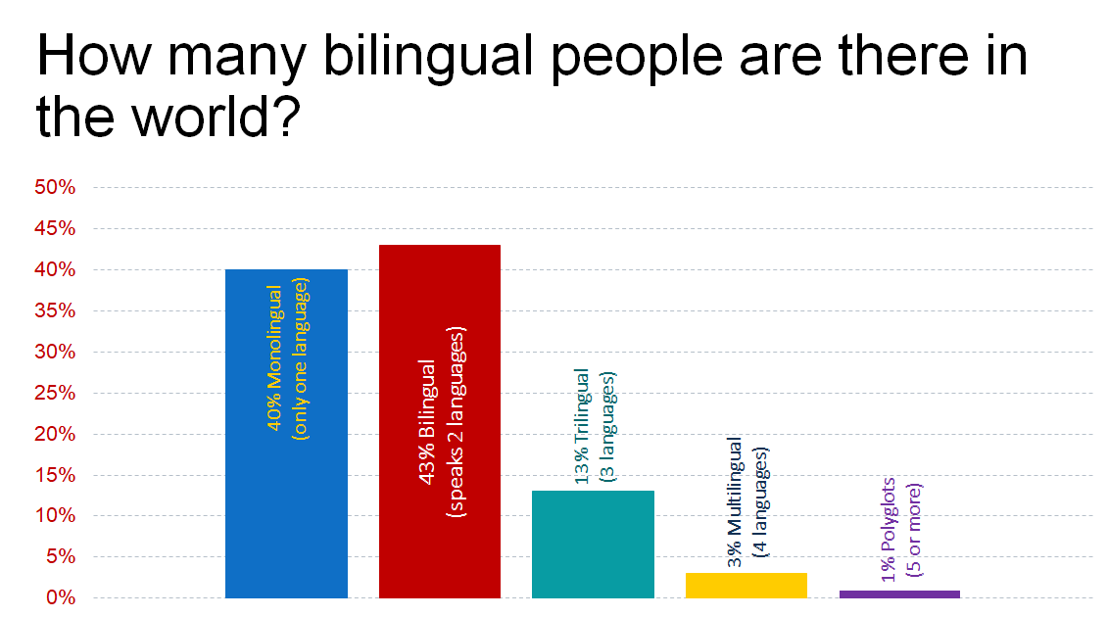
Notes:
Languages are important in the world. A large proportion of people throughout the world does not speak English as its first or even second language. English is the first language of only 5% of the world’s population. 60% of the world’s population can speak at least 2 languages. If you only speak one language you are in the minority with 40% of people in the world who are monolingual. It is definitely not true that everyone speaks English. This graph shows that 43% are bilingual (speak 2 languages fluently), 13% trilingual (3 languages), 3% multilingual (4 languages) and 1% are considered polyglots (5 or more languages).

Slide 3

Everyone speaks English so who needs to learn a language?
“English is fine if you want to buy things, but it's not the right language to use for people who want to sell things”
“the assumption that everyone speaks English cost UK economy around £48bn a year”
Notes:
Audio is 1 min 40 and plays automatically

Slide 4

I can just use Google translate
Notes:
Click on video to play. Finish at 7.02

Slide 5

Skills developed when learning a language:
Flexibility & Adaptability
Open minded
Communication skills
Better memory
Multitasking skills
Problem solving skills
Ability to function out of your comfort zone
Willingness to learn something new (out of your subject area)
Improve your English

Slide 6

Typical modern language jobs...
International development worker
Tourism
Hospitality
Diplomacy
Broadcast journalist
Business
Sports teams
Engineering
Marketing, advertising and public relations
Journalism
Film
Arts
And many more...
Notes:
You may think that jobs with languages means teaching, translating or interpreting. This is true, however there are so many other fields as well. In this area alone we have Luton Airport, Vauxhall, Mercedes and Nissan amongst others who are always looking for people with a language. Not to mention how close we are to London where foreign languages are prolific

Slide 7
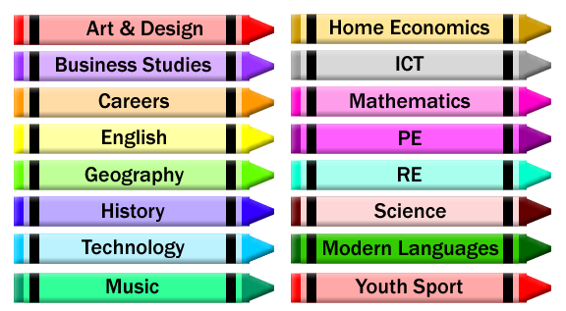
Languages combine well with...
Drama
Film studies
Sport
Economics
in fact any subject you can think of...
Notes:
when choosing your options look how well languages combine with other subjects. They help you to understand the English language as well as give you an insight into other cultures. Taking a language at GCSE and beyond will mean that you stand out from the crowd when you apply for university and jobs.

Slide 8

Facts about language graduates...
have above average salaries
are more likely to be employed abroad
are more likely to be employed within six
months after graduating
64% of employers consider international
experience as important for recruitment
(Erasmus Impact Study 2014)

Slide 9
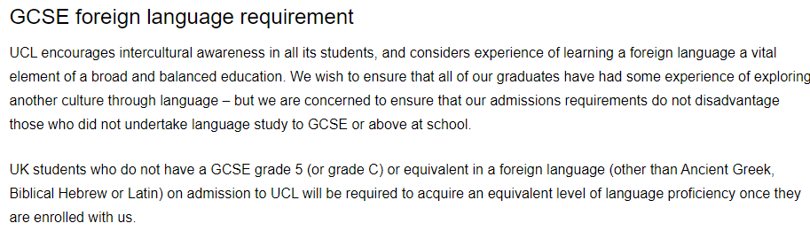
Do your research
Some students in the past have told us they were rejected from a university course because they didn’t have a GCSE language.
UCL currently require you to reach GCSE level 5 proficiency in a modern language on admission to the course if you don’t already have one.

Slide 10
French at Redborne
Pearson Edexcel
The GCSE is made up of 4 papers each worth 25%
Papers 1 – LISTENING
  Questions are very similar in style to the year 9 end of module assessments
Paper 2 – SPEAKING
  Individual exam in May of year 11 with just you and your class teacher
Paper 3 – READING
  Questions are very similar in style to the year 9 end of module assessments including some translation from French into English
Paper 4 – WRITING
  A range of writing tasks varying in length between 30 words and 150 words and a translation into French
Notes:
No va in Spanish means doesn’t go

Slide 11
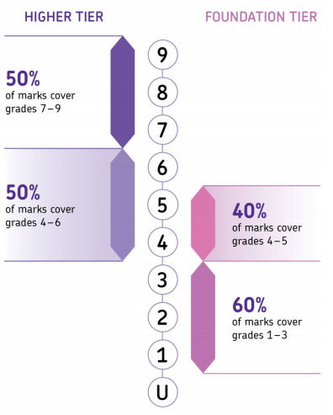
Higher or Foundation?
Depending on your ability in French you will take either Foundation (grades 1 – 5) or Higher (grades 4 – 9)
The decision on which tier you will take is made in January of year 11
You can’t mix and match tiers but can try foundation and higher in the year 10 / year 11 mocks to help you and your teacher decide

Slide 12
What grade am I likely to get?
This will depend on your ability but also on your commitment to the course. In particular if you want to succeed you need to dedicate time to learning vocab every week.
Past results show that students at Redborne do extremely well at French:
          2020 - 100% of students achieved grades 9 – 4
          - 65% achieved 9 - 7, 88% grades 9 - 5
          2019 - 97% of students achieved grades 9-4
      - 79% achieved 9 - 5. 64% of students beat their indicator grade
          2018 - 98% of students achieved grades 9-4
          - 62% achieved 9 - 7, 85% grades 9 - 5

Slide 13
Does it get much harder than now?
You have been laying the foundations for the GCSE since you started learning French in year 5.
This year a number of the reading and listening exercises you have completed have been taken from GCSE textbooks
Some of the assessment tasks have been adapted from GCSE foundation exams.
During the GCSE you will revisit topics and expand your vocabulary for these as well as look at new topics such as the world of work and Global dimensions.
We recap all of the tenses and grammar, so don’t worry if you missed learning how to form the present tense.

Slide 14

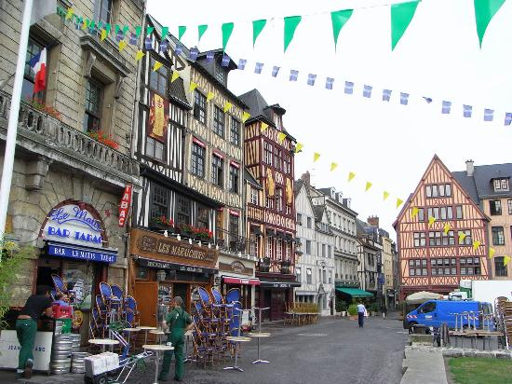

I would recommend this trip as it helps build your confidence in speaking French.
I enjoyed the free time the most as it enabled me to converse with the locals
I am now happier to speak French.
French trip
to Rouen
The families were so nice and helpful.
I got to discover lots of interesting French culture.
You truly immerse yourself into the French lifestyle.
Notes:
The French trip to Rouen takes place in October and is for years 10 – 13. It gives students the opportunity to experience life in a French family, have lessons in the French language school and visit the very picturesque centre of Rouen for plenty of time for shopping or sampling the food and drink in a café. In 2018 we had the opportunity to visit Paris; In 2019 we visited Monet’s house and gardens and the very pretty fishing town of Honfleur where many of us enjoyed tasting the local crepes.

Slide 15

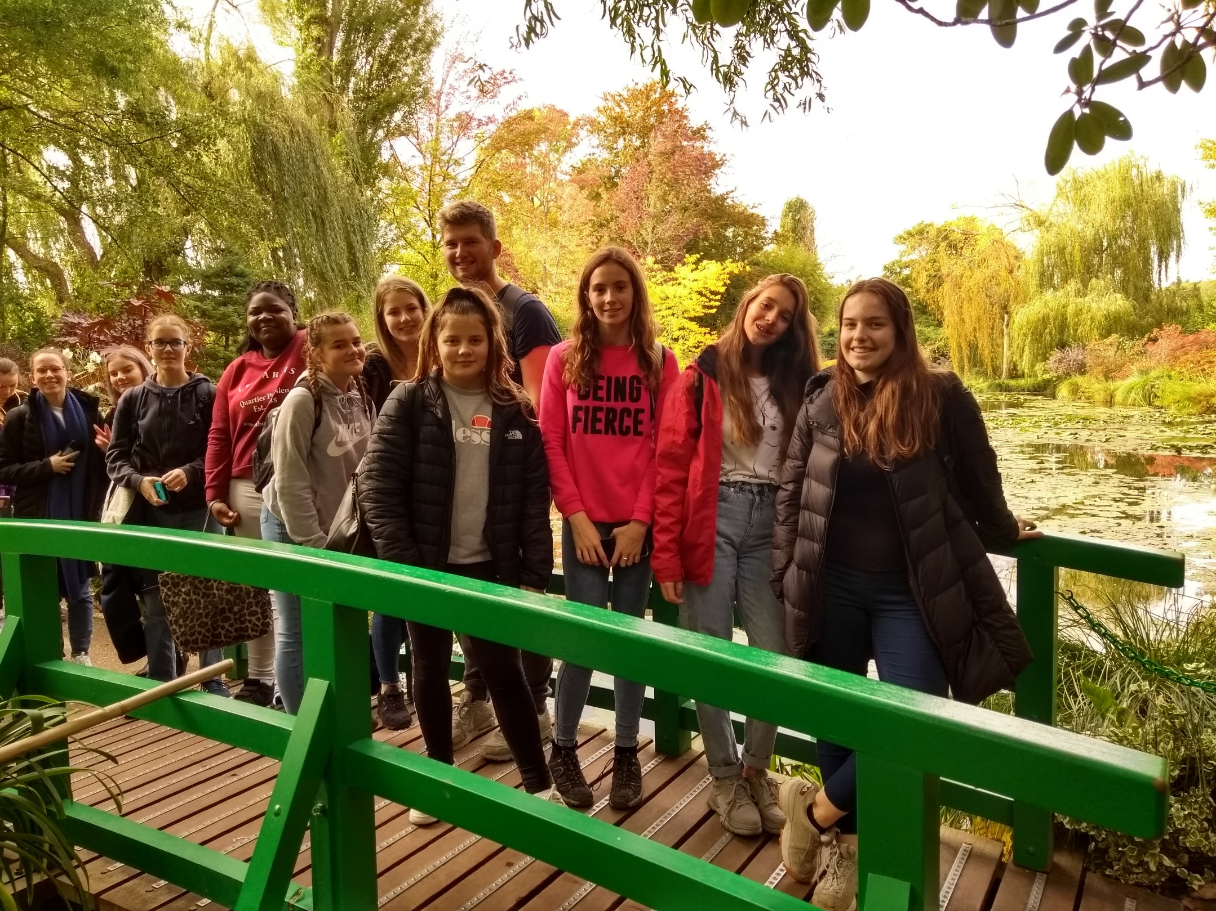
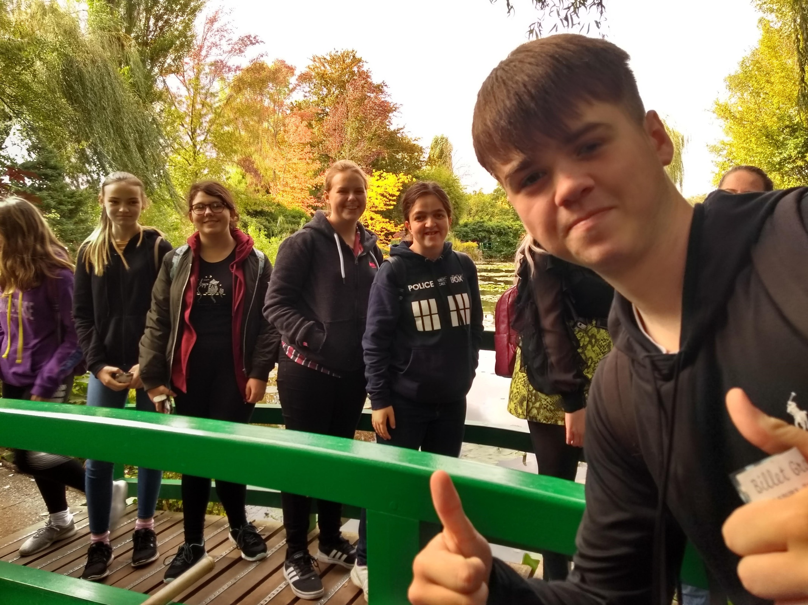
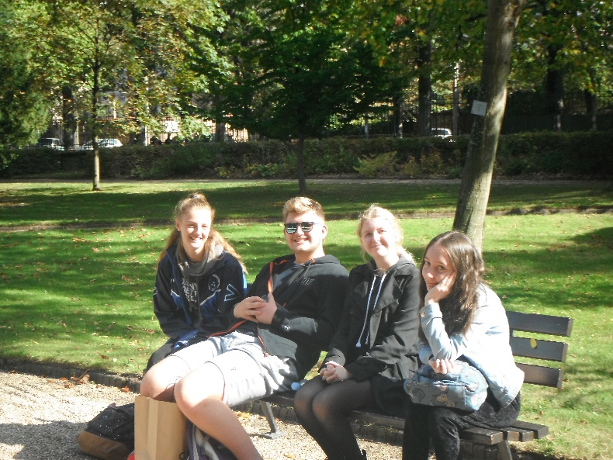

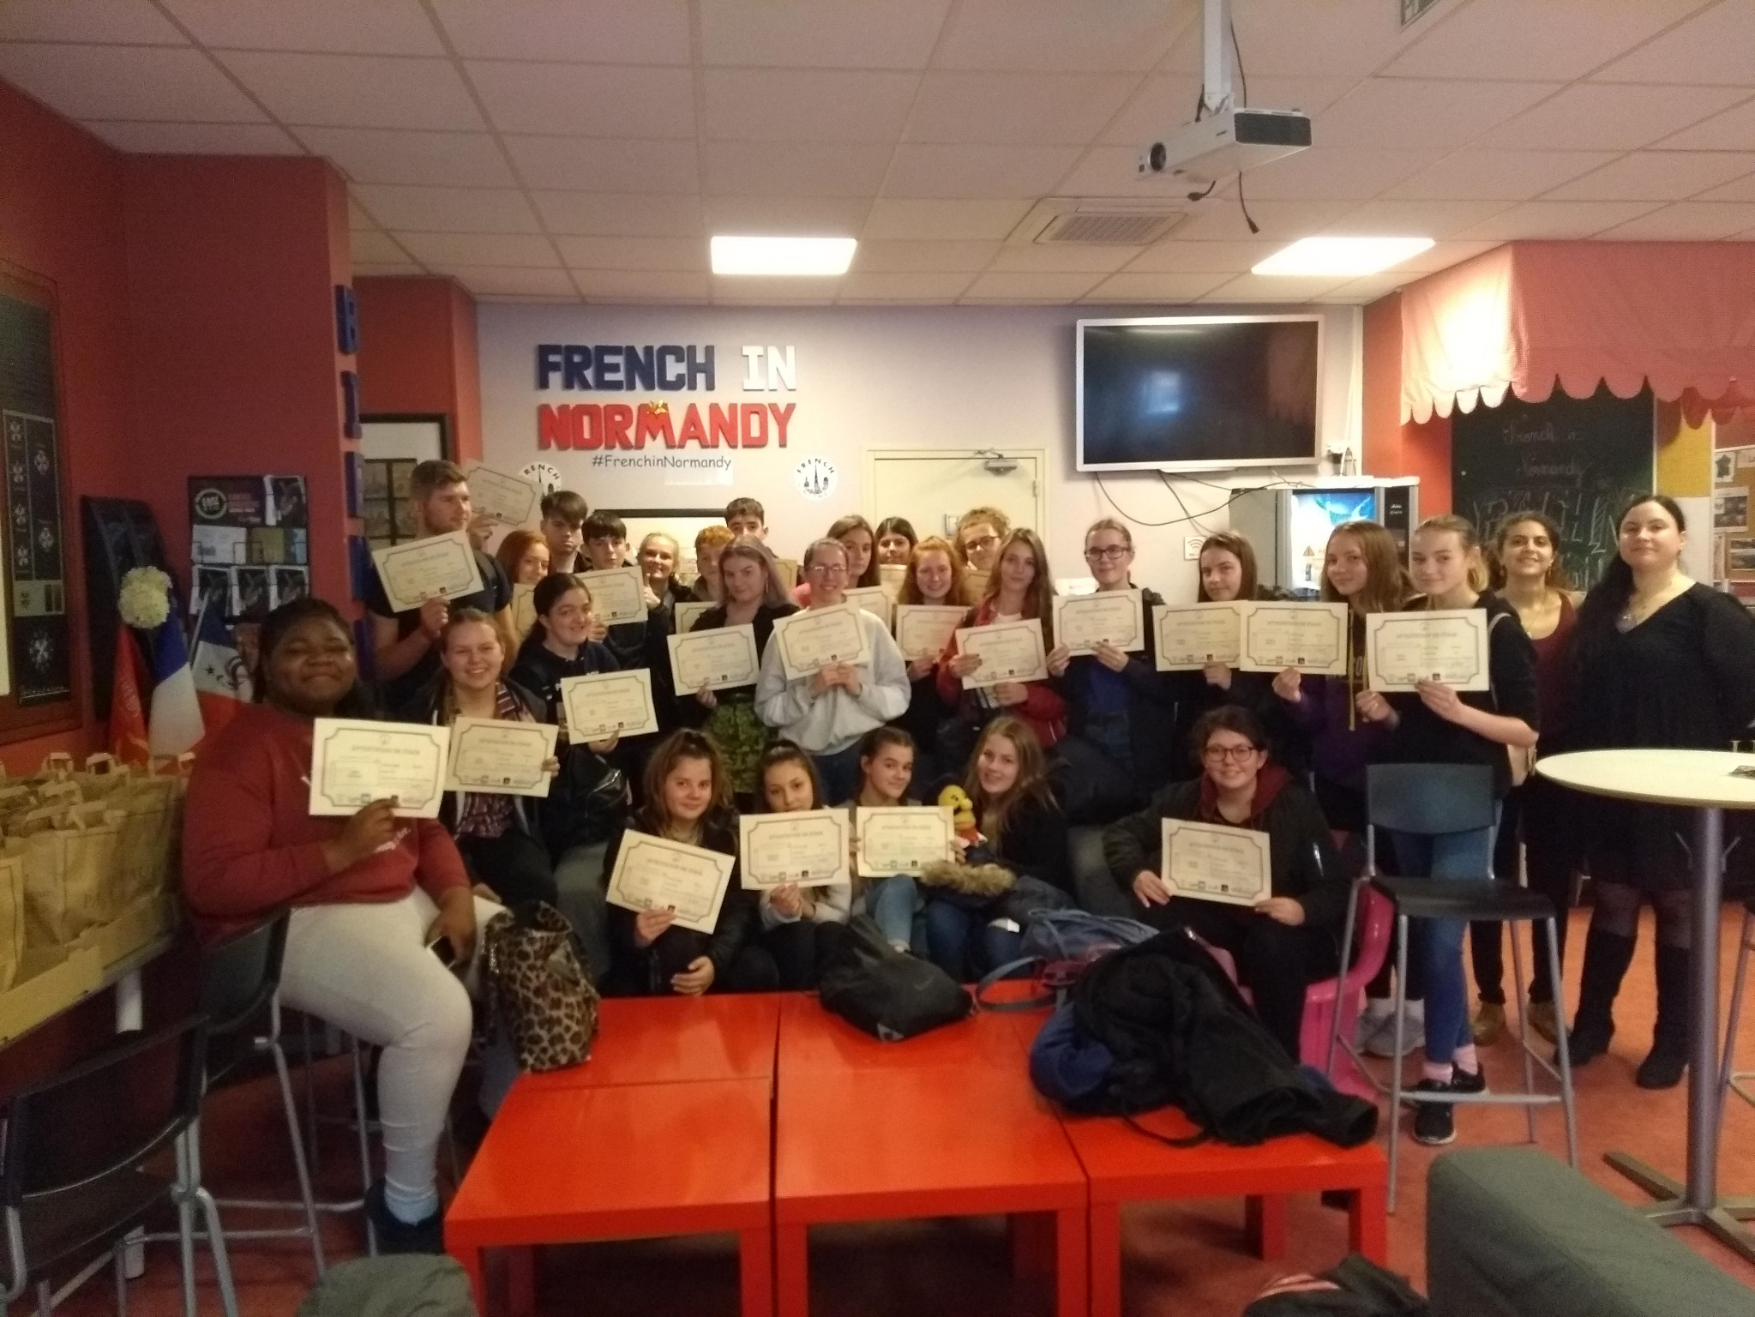
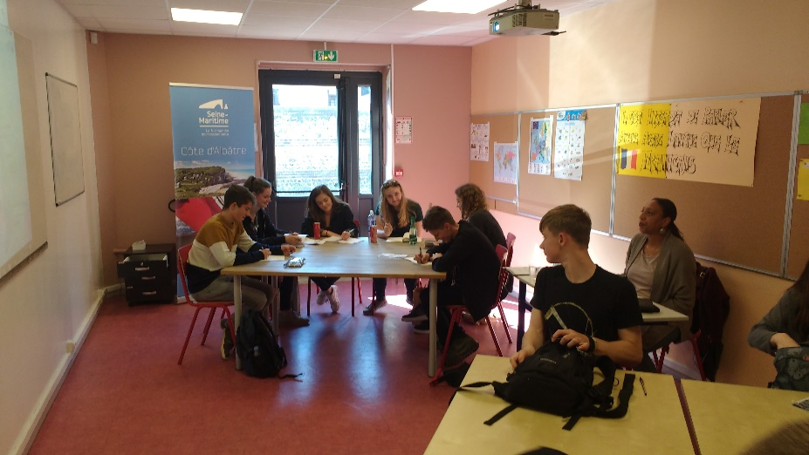



Slide 16
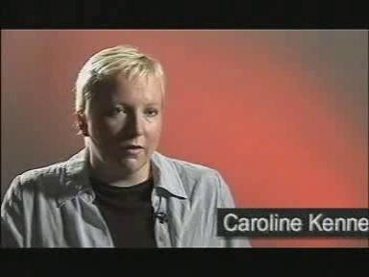

Slide 17
Independent work
Choose from the following:
Watch the rest of the videos in this slide show
Read the FAQs on slides 19 – 22
Research jobs / courses that learning a language would help
Find out more about French speaking countries
Create a quiz on why it is important to learn languages based on this slideshow
Any Questions
Ask your teacher or email tricia.shaw@redborne.com / nicola.crossley@redborne.com

Slide 18

Five things you didn't know about GCSE Languages

Slide 19

Why French?
9 reasons to learn French

Slide 20

How languages help in your career

Slide 21
I’ve decided what I want to do in the future and it doesn’t need a language so why keep doing one?
It’s very difficult to be sure these days that learning a foreign language won’t be either necessary or useful to a chosen career path. There are some jobs where it’s an integral part, some where it is a useful bonus and others where it is just an advantage because it indicates a general ability level and open outlook. One thing that you can be sure of – it is never a disadvantage to have studied a language.

Slide 22
Languages are the most difficult subject I don’t feel that I am any good at them. Should I use up an option choice on a language?
In today’s world I think learning a foreign language is something should be seen as much an essential skill for life as say, driving or ICT skills. It is always something that you would want to write on your CV, regardless of the job you are applying for. It says something about the individual’s outlook; that they are flexible, adaptable and open to new challenges. But more than this, there are two key things that make language learning essential rather than optional: first, it remains the case that 75% world’s population speaks no English and second, the fact that most young people who are non-native English speaking are ensuring that they learn it, means that English is no longer a significant advantage to any British person entering the job market. If all those competing for the better jobs in a country can speak English, then those with other languages will have the edge.

Slide 23
I haven’t enjoyed languages up to now.
How is GCSE different?
Languages get more enjoyable as you get better at them. You should find that as you are able to express yourself better on a wider range of topics you will get more of a sense of achievement and appreciate what you are able to do independently with the language. Also, the GCSE course now offers much more choice and flexibility in terms of the main topics that you will concentrate on for speaking and writing so you will find it interesting.

Slide 24
I have read somewhere that languages are the most difficult subject to do well in at GCSE, is it true?
I am not sure that languages are the most difficult subject to do well in – I think a lot depends on the learner of course. However it is true that, relative to other GCSEs, language GCSEs are more difficult than most, probably most comparable to Maths GCSE. But if languages are perceived as difficult, they may also attract greater recognition from Higher Education providers and employers – it stands to reason that they will be valued more highly as a result of the perceived difficulty. And in addition to the academic value, we shouldn’t forget that learning a foreign language is a life skill, akin to ICT skills or driving a car.

Slide 25

Live a life without limits!!!

